Slide 1



OBE IMPLEMENTATION:
COURSE OUTCOME SETTING
Submitted by:
AP22110010080 – Hema Kakarlapudi
AP22110010076 – Venkata Naga Harshit Gulipali
AP22110010089 – Shanmukha Krishna Chaitanya Munagala
AP22110010108 – Srija Yadla
AP22110010082 – Rammohan Rao Namburi

Slide 2
INTRODUCTION
Our University (herewith considered as SRM-AP) is going to implement OBE(Outcome
Based Education) in their university and you are assigned in the project to develop a
CURD(Create,Update,Retrieve and Delete) windows and mobile application using JAVA
programming and Android studio for the same.
Project Modules:
Various Modules available in the project are
1.Blooms Level setting
2.Program Level Objective Setting
3.University
4.Schools
5.Department
6.Programs
7.Courses
8.Course objective setting
9.Course Outcome Setting
10.Course Articulation matrix Setting
11.Course Utilization Setting
12.Course Reference Setting.

Slide 3
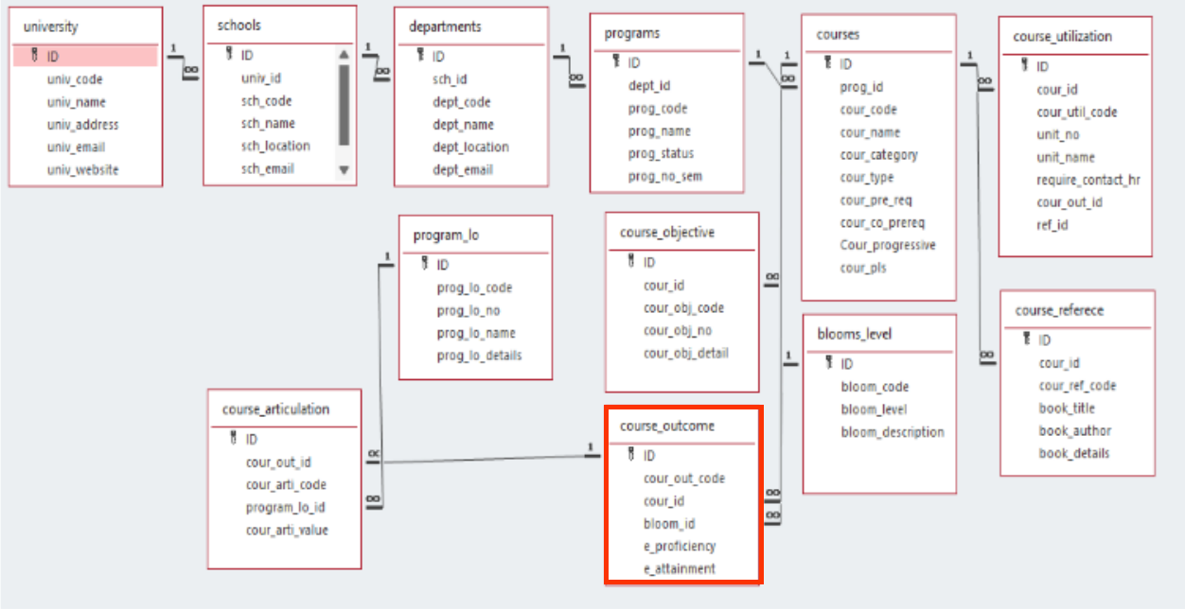
Architecture Diagram[Course Outcome Setting]

Slide 4

Module Description
Module Name:Course Outcome Setting
Module Descroiption:
The Course Outcome Module is responsible for managing course related Outcomes, including bloom,proficiency,attainment.This Module allows users to Create,Update,Retreive and Delete course-outcome records,ensuring efficient storage and retrival of information.This data is stored in a relational database such as MySQL or SQLite, and the module interacts with it using Java JDBC.

Slide 5

Programming Details
class name:TechTitans_Course_Outcome
Function/method name
Create: void insertData()
Update: void updateData()
Retrieve: void displayData()
Delete: void deleteData()

Slide 6



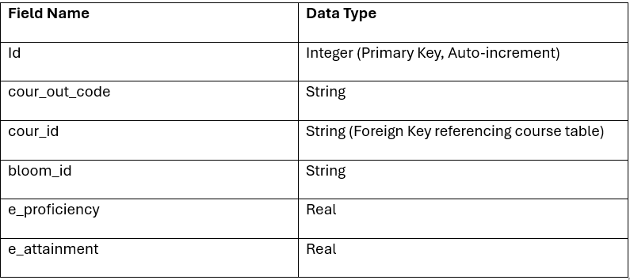
Table details

Slide 7
SOURCE CODE
Database Connection
void connect() {
try {
conn = DriverManager.getConnection("jdbc:sqlite:javaapp.db");
} catch (Exception e) {
e.printStackTrace();
}
}

Slide 8
SOURCE CODE
Create/Insert
void insertData() {
try {
String sql = "INSERT INTO course_outcome (cour_out_code, cour_id, bloom_id, e_proficiency, e_attainment) VALUES (?, ?, ?, ?, ?)";
PreparedStatement pst = conn.prepareStatement(sql);
pst.setString(1, tfCode.getText());
pst.setString(2, tfCID.getText());
pst.setString(3, tfBloom.getText());
pst.setString(4, tfProficiency.getText());
pst.setString(5, tfAttainment.getText());
pst.executeUpdate();
displayData();
clearFields();
} catch (Exception ex) {
ex.printStackTrace();
}
}

Slide 9
SOURCE CODE
UPDATE
void updateData() {
int selected = table.getSelectedRow();
if (selected >= 0) {
try {
String id = model.getValueAt(selected, 0).toString();
String sql = "UPDATE course_outcome SET cour_out_code=?, cour_id=?, bloom_id=?, e_proficiency=?, e_attainment=? WHERE id=?";
PreparedStatement pst = conn.prepareStatement(sql);
pst.setString(1, tfCode.getText());
pst.setString(2, tfCID.getText());
pst.setString(3, tfBloom.getText());
pst.setString(4, tfProficiency.getText());
pst.setString(5, tfAttainment.getText());
pst.setInt(6, Integer.parseInt(id));
pst.executeUpdate();
displayData();
clearFields();
} catch (Exception ex) {
ex.printStackTrace();
}
}
}

Slide 10
SOURCE CODE
RETRIVE
void displayData() {
model.setRowCount(0); // Clear existing table data
try {
Statement stmt = conn.createStatement();
ResultSet rs = stmt.executeQuery("SELECT * FROM course_outcome");
while (rs.next()) {
model.addRow(new Object[]{
rs.getInt("id"),
rs.getString("cour_out_code"),
rs.getString("cour_id"),
rs.getString("bloom_id"),
rs.getString("e_proficiency"),
rs.getString("e_attainment")
});
}
} catch (Exception e) {
e.printStackTrace();
}
}

Slide 11
SOURCE CODE
DELETE
void deleteData() {
int selected = table.getSelectedRow();
if (selected >= 0) {
try {
String id = model.getValueAt(selected, 0).toString();
String sql = "DELETE FROM course_outcome WHERE id=?";
PreparedStatement pst = conn.prepareStatement(sql);
pst.setInt(1, Integer.parseInt(id));
pst.executeUpdate();
displayData();
clearFields();
} catch (Exception ex) {
ex.printStackTrace();
}
}
}

Slide 12
SOURCE CODE
CLEAR INPUT FIELDS
void clearFields() {
tfCode.setText("");
tfCID.setText("");
tfBloom.setText("");
tfProficiency.setText("");
tfAttainment.setText("");
}

Slide 13
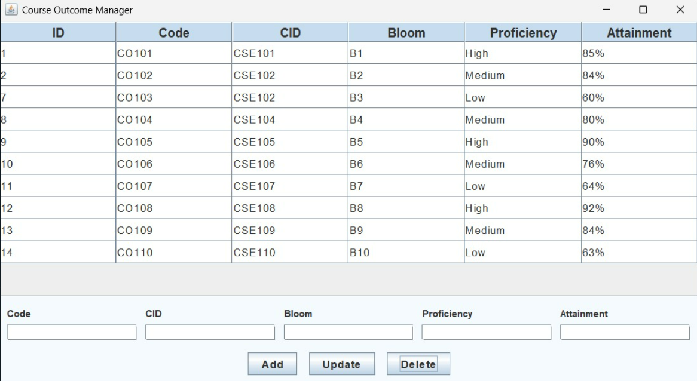
SAMPLE SCREENSHOTS
On Loading the window:Already Stored Records in Databases are Displayed

Slide 14

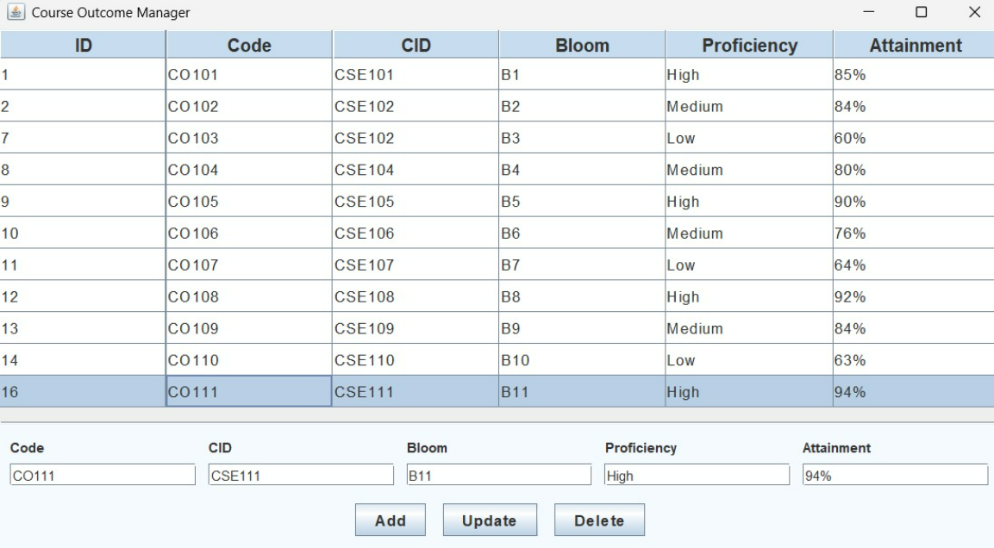
SAMPLE SCREENSHOTS
ADDING a Record with ID : 16, CODE:CO111

Slide 15
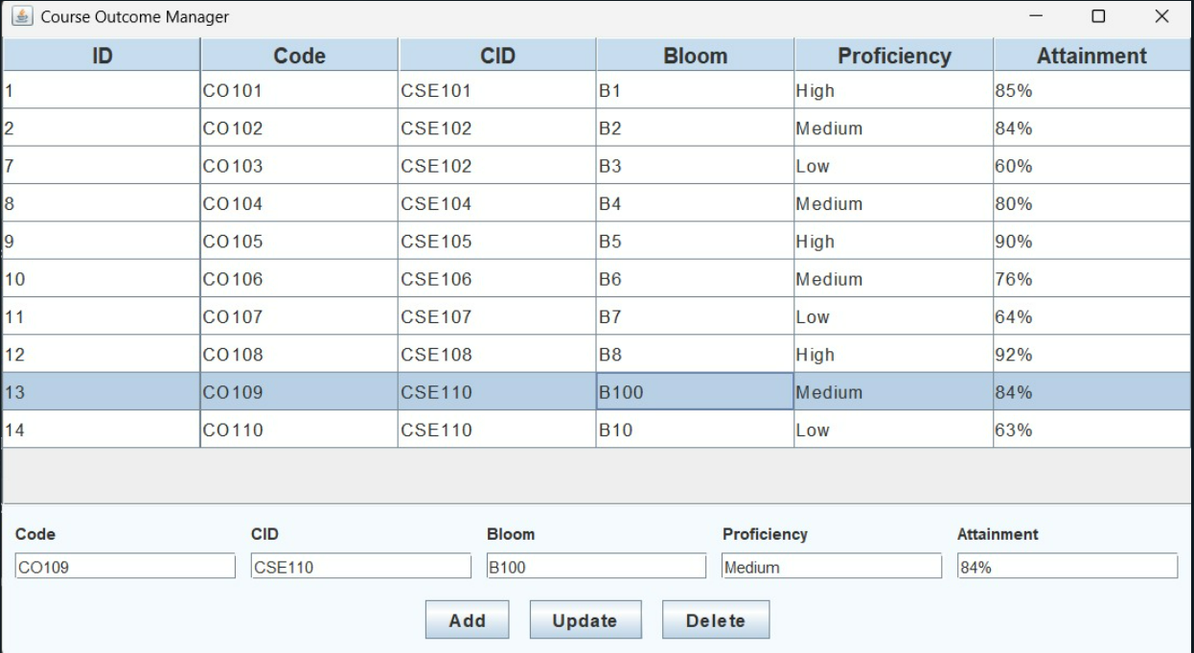
SAMPLE SCREENSHOTS
Updating a Record ID-13 BLOOM is updated to B100

Slide 16
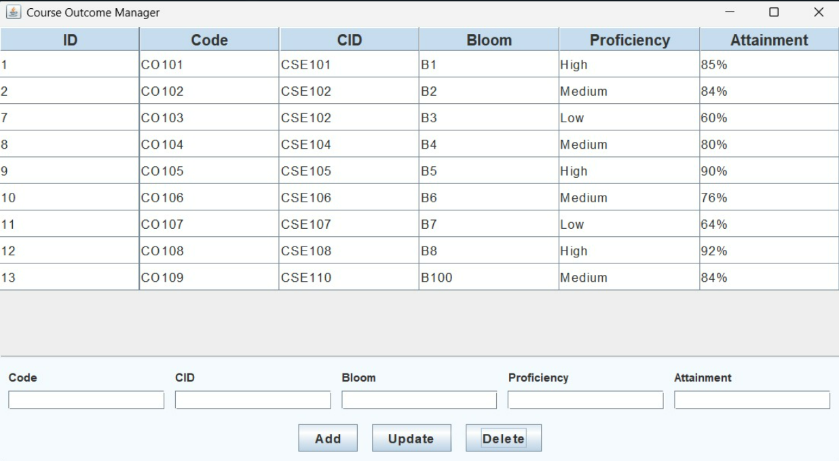
SAMPLE SCREENSHOTS
Delete: ID-14 Record is deleted

Slide 17
CONCLUSION
The TechTitans project successfully demonstrates the integration of Java with SQLite using the sqlite-jdbc library. Through this project, a dynamic desktop application was developed to interact with a lightweight local database, achieving essential CRUD (Create, Read, Update, Delete) operations. This hands-on experience has enabled a deeper understanding of:
Java's JDBC architecture and database connectivity
Executing SQL queries through Java
Managing data persistence using SQLite
Building a functional and modular Java application with real-time user interaction
The project helped bridge the gap between theory and practical implementation, empowering students with key software development skills. Additionally, it highlighted the importance of structured error handling, code reusability, and clear user interface design in application development.

Slide 18


Thank you!

